Slide 1

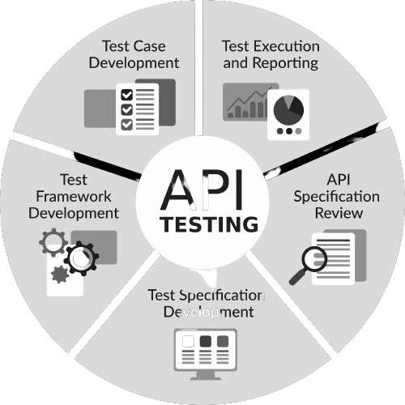
API Testing Mastery
Pramod Dutta Lead SDET.
API Testing - Get Started!!

Slide 2
Agenda of Session
Who should learn API Testing
Why We should Learn API Testing?
What is API?
What is API Testing?
Types of APIs
SOAP Vs REST
What To Test in APIs?
Manual Testing Concepts to Design API Test cases.

Slide 3
Before We Start…..
Join Private Telegram
https://sdet.live/apibatch

Slide 4

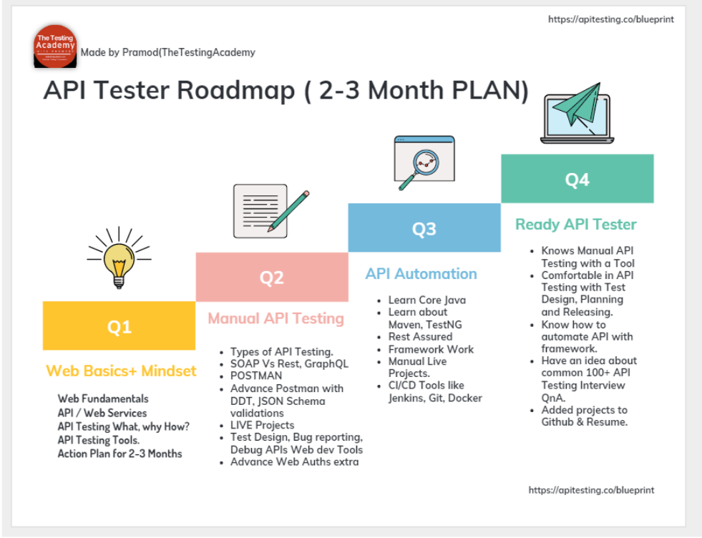
API Tester ROADMAP

Slide 5
Who should learn API Testing
If you are Manual Tester? -> API Testing is Must to have
If you are Automation Tester - API Testing is Must
Fresher? -> Must have API Testing
You can switch from Manual to Automation using APIs.
Non IT want to start to IT Software Testing.

Slide 6
Why we need to Learn API Testing?
- Companies are moving towards Microservices Architecture.
- API Testing is must to have skill nowadays for Freshers, Manual Tester and Automation Testers or Devs.
- Many Companies are especially hiring API Testers.
- API Test are more reliable, easy to create, and stable, less complex and provide more coverage as Business layer level.

Slide 7
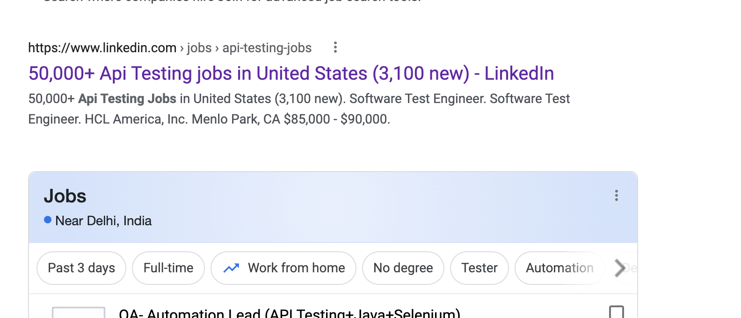
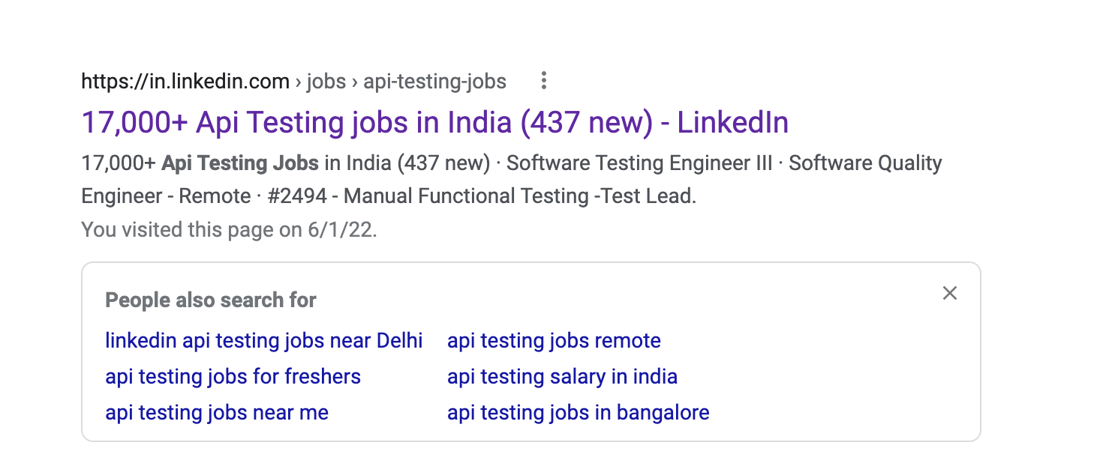
JOBs in API Testing
https://wingify.hire.trakstar.com/jobs/fk0udde/

Slide 8
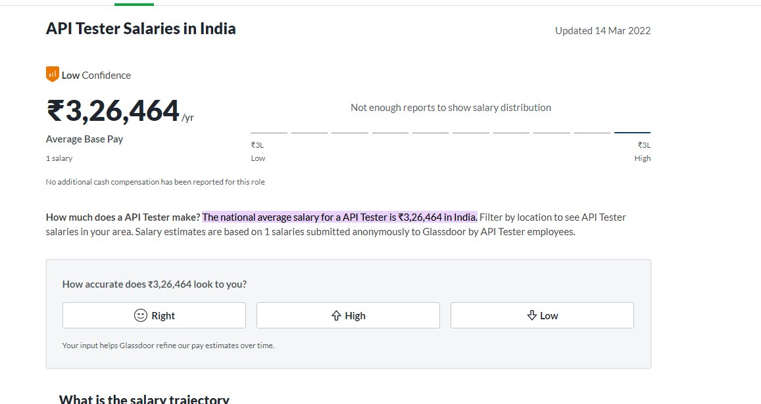
Salary of Testing
https://www.glassdoor.co.in/Salaries/api-tester-salary-SRCH_KO0,10.htm#:~:text=The%20national%20average%20salary%20for,%E2%82%B93%2C26%2C464%20in%20India.

Slide 9
LIVE Research, Now See This
Click here
https://www.linkedin.com/jobs/search/?currentJobId=3131328580&keywords=software%20tester

Slide 10
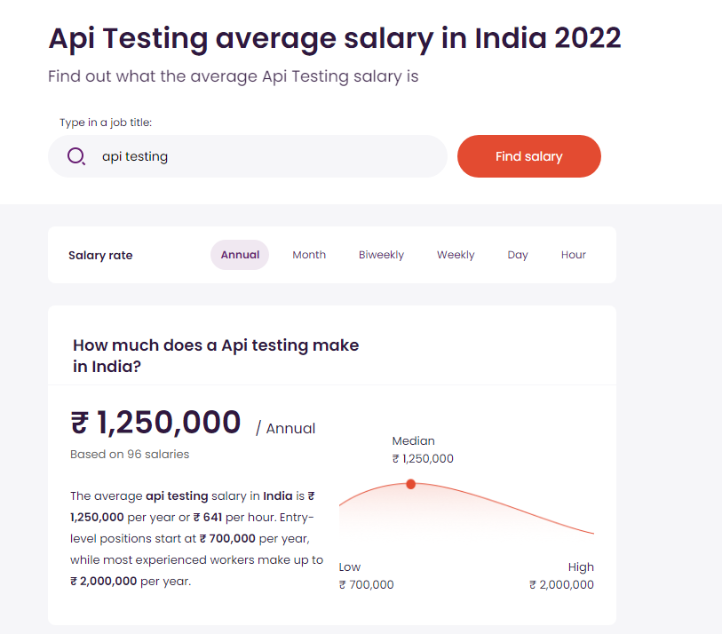
Salary of Testing
https://in.talent.com/salary?job=api+testing

Slide 11
Do you know What is API?
Yes
No
In Comments

Slide 12
State of API Report 2023
APIs are rapidly growing.
New Tools are Coming to Test APIs
API Testers are needed or mandatory to learn now days
API Automation is also important.
People are migrating test cases from, UI to APIs
https://sdet.live/api-report

Slide 13

Why API Testing?
Millions of Web Apps and Mobile Applications use APIs.

Slide 14
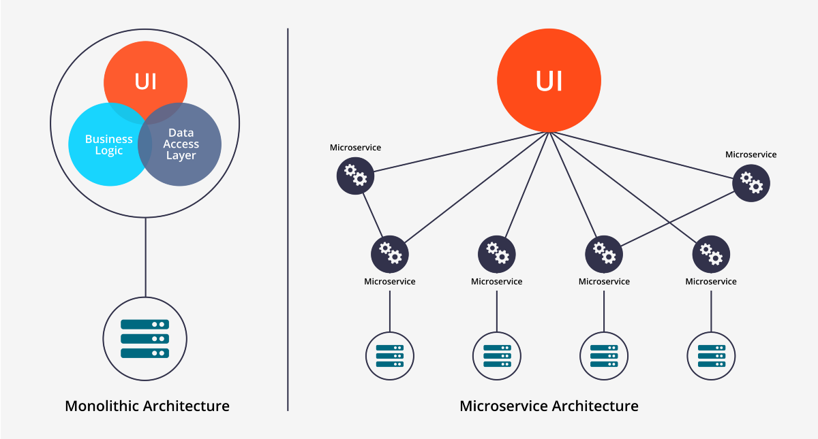
Why API Testing?
MicroServices Architecture.

Slide 15
Microservices
Architectural style that structures an application as a collection of services
Highly maintainable and testable
Loosely coupled
Independently deployable
Organized around business capabilities
Owned by a small team Read more - https://microservices.io/

Slide 16
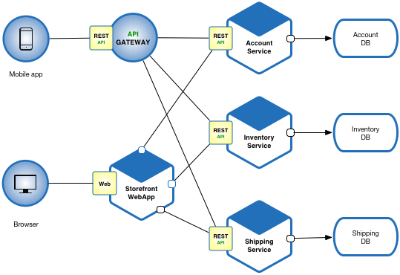
Microservices

Slide 17
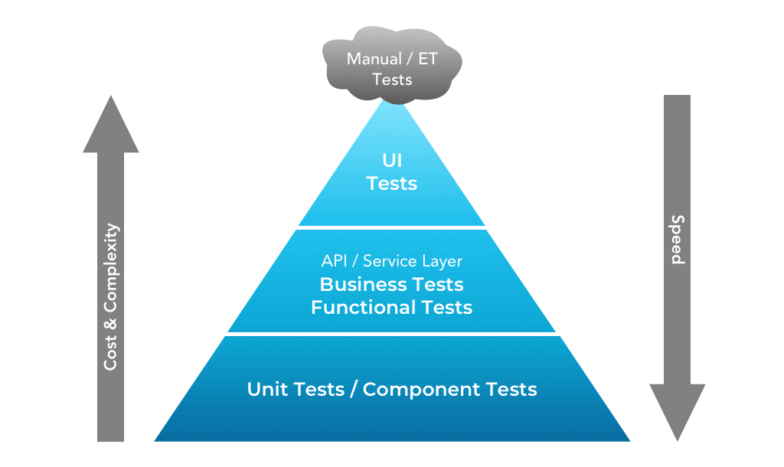
Why API Testing?
Why API Testing?
UI Testing is costly.
API Testing is easy and can caught early Bugs.

Slide 18
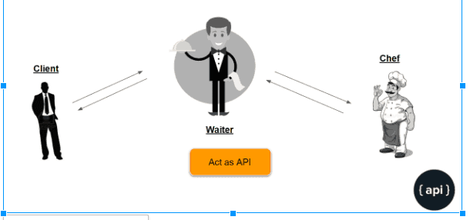
What is API ?
API stands for the Application Programming Interface,

Slide 19
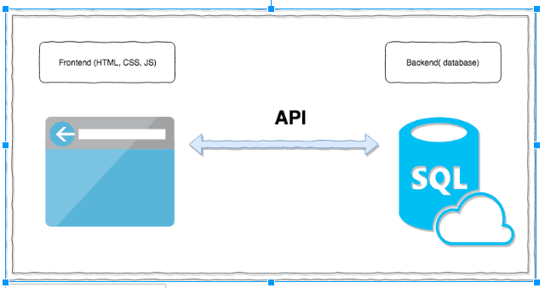
What is API ?
Basically a collection of functions and procedures which allows us to communicate two applications or libraries.

Slide 20
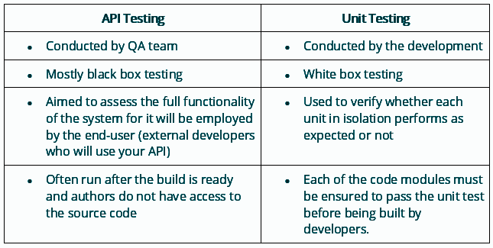
What are differences between API Testing and Unit Testing?

Slide 21
API Vs Web Service
All Web Services are API, But All APIs are not web services.
Web Services uses Three Styles, REST, XML-RPC, SOAP

Slide 22
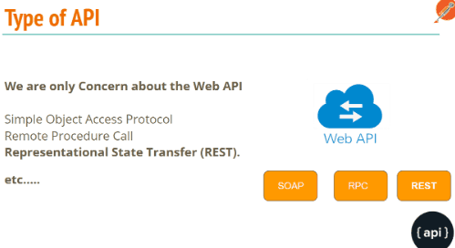
Type of APIs :
We are going to Learn REST API Testing.

Slide 23
SOAP

Slide 24
SOAP
SOAP is an acronym for Simple Object Access Protocol.
It is an XML-based messaging protocol for exchanging information among computers.
SOAP is an application of the XML specification.

Slide 25
SOAP
SOAP is a communication protocol designed to communicate via Internet.
SOAP can extend HTTP for XML messaging.
SOAP provides data transport for Web services.
SOAP can exchange complete documents or call a remote procedure.
SOAP can be used for broadcasting a message.
SOAP is platform- and language-independent.
SOAP is the XML way of defining what information is sent and how.
SOAP enables client applications to easily connect to remote services and invoke remote methods

Slide 26
SOAP
SOAP is a communication protocol designed to communicate via Internet.
SOAP can extend HTTP for XML messaging.
SOAP provides data transport for Web services.
SOAP can exchange complete documents or call a remote procedure.
SOAP can be used for broadcasting a message.
SOAP is platform- and language-independent.
SOAP is the XML way of defining what information is sent and how.
SOAP enables client applications to easily connect to remote services and invoke remote methods

Slide 27
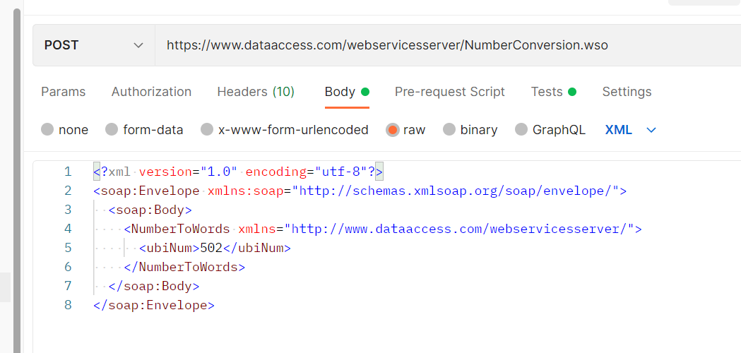
SOAP
https://documenter.getpostman.com/view/611814/2s93Y5Pewv

Slide 28
REST API?

Slide 29
What is REST API?
REST is an acronym for REpresentational State Transfer.
The REST architectural style describes six constraints.
These constraints, put on the architecture, were initially communicated by Roy Fielding in his doctoral dissertation and defines the basis of RESTful-style.

Slide 30
What is REST API?
In Simple Terms REST API is nothing but a Design Pattern for Web API

Slide 31
REST Constraints
Uniform Interface
Stateless
Cacheable
Client-Server
Layered System
Code on Demand
https://scrolltest.com/rest/explained

Slide 32
Stateless
Stateless: It means that the necessary state to handle the request is contained within the request itself and server would not store anything related to the session.
In REST, the client must include all information for the server to fulfill the request whether as a part of query params, headers or URI.
Statelessness enables greater availability since the server does not have to maintain, update or communicate that session state

Slide 33
Cacheable
Every response should include whether the response is cacheable or not and for how much duration responses can be cached at the client side.
Client will return the data from its cache for any subsequent request and there would be no need to send the request again to the server.
But sometime there are chances that user may receive stale data.
Well-managed caching partially or completely eliminates some client-server interactions, further improving scalability and performance.

Slide 34
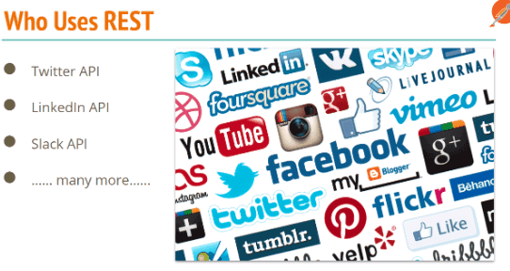
REST Used by ….
Most of WebApps, Mobiles are relying on REST API

Slide 35
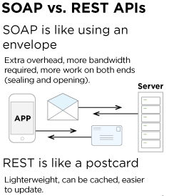

Slide 36
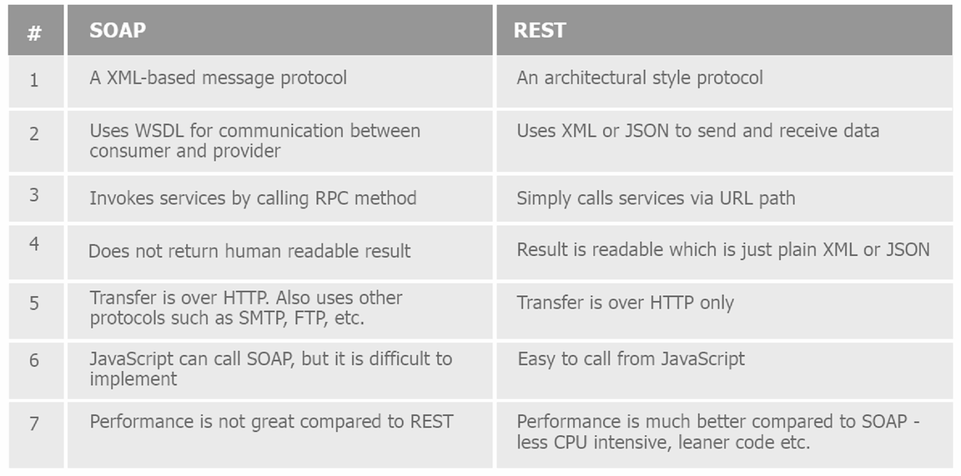
SOAP Vs REST

Slide 37
What To Test in APIs?

Slide 38
What To Test in APIs?
Verify the Parses JSON or XML response.
HTTP Status Code.
Verify Headers response with Negative or invalid headers.
Max/ Min Key values.
Have a test case to do XML, JSON Schema validation.
Verify that how the APIs error codes handled.
Missing Keys
Empty Updates or POST call handling.
Chaining request verification.
End to End Crud.
Database integrity test
File upload.

Slide 39
What is Test in APIs?
Test nulls and empty strings, these have a habitat of causing issues ;).
Test with Unicode characters, ensure they are correctly saved to the database.
Test mandatory and optional parameters, in particular test with just mandatory values.
Ensure correct status codes are returned, you will find false positives e.g a 500 being returned as a 200.
Functionality Bugs: the test looks for missing functionality bugs
Reliability Bugs: API testing helps identify bugs pertaining to integration across different systems
Performance Bugs: The tests help determine how much traffic the system can handle before being overloaded, and how to expand infrastructure to meet rising demand at the core, but also are very effective at pinpointing weak points in the API
Security Bugs

Slide 40
Common Bugs in API?
Missing Keys
Duplicate Keys
Incorrect HTTP Code.
HTTP Methods not handled properly
Performance issues
Security issues
Validation errors
API Monitoring issues

Slide 41
Manual Testing Concepts to Design API Test cases.
Boundary Value Analysis (BVA)
Equivalence Class Partitioning
Decision Table based testing
Error Guessing
State Transition

Slide 42
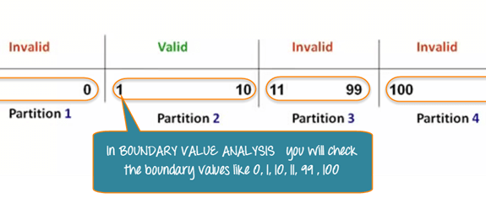
Boundary Value Analysis.

Slide 43
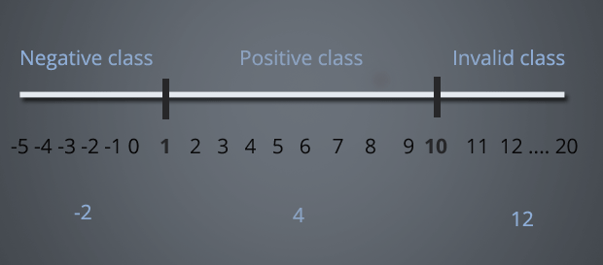
Equivalence Class Partitioning

Slide 44
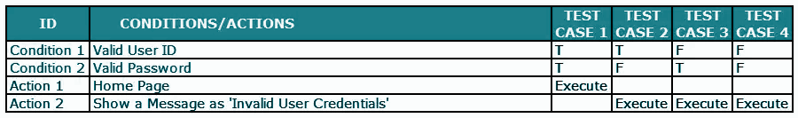
Decision Table based testing

Slide 45
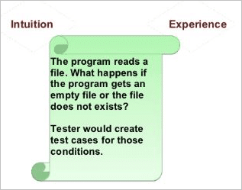
Error Guessing

Slide 46
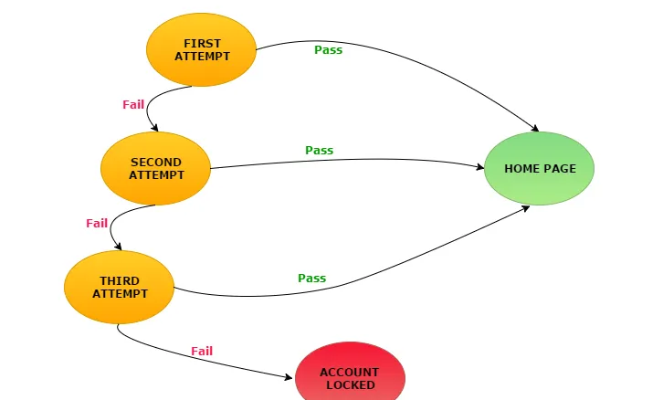
State Transition
Take an example of login page of an application which locks the user name after three wrong attempts of password.

Slide 47
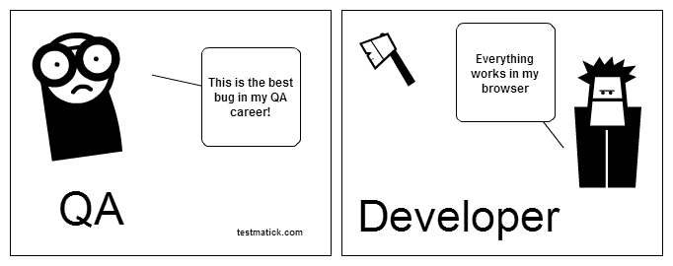
Reason

Slide 48
Type of Testing in API Testing?

Slide 49
Functional Testing.
Integration Testing
Regression Testing
Security Testing
Load Testing
Penetration Testing
Fuzz testing - injects invalid, malformed, or unexpected inputs into a system to reveal software defects

Slide 50
POSTMAN Basics

Slide 51
POSTMAN Basics
OverView
Import External Request.
History
WorkSpace in Postman
Postman Tabs - Param, Auth, Headers, Body, Pre-req, Post Req(Test), Settings
Postman Console.

Slide 52
Quiz
Can we use POST request to do all Request?

Slide 53
Thanks, for attending Class
I hope you liked it. Say Thanks in Comment :)

Slide 54
Fin.

